Slide 1
CS-GY 6313 B: Information Visualization
11/21/2024

Slide 2
Logistics
Assignment 4 due Friday, Nov 22 @ 11:59pm
Guest lecture Dec 5:
Dr. David Saffo and Dr. Benjamin Lee @ JPMC
3D + immersive viz
Bring your laptop!
Today:
Research and modern topics in viz
Final project office hours/feedback?

Slide 3
Data Visualization Research
We now know the fundamentals and the tools
What is the cutting edge of data viz research?

Slide 4
AI/Machine Learning

Slide 5
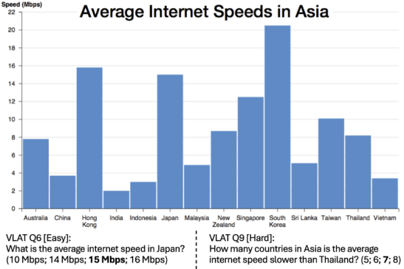
Visualization Literacy of LLMs
Question: Can Large Language Models (LLMs) read visualizations?
Study:
Visualization Literacy Assessment Test (VLAT)
Lee, Sukwon, Sung-Hee Kim, and Bum Chul Kwon. "Vlat: Development of a visualization literacy assessment test." IEEE transactions on visualization and computer graphics 23.1 (2016): 551-560.
Chart Question Answering
Kim, Dae Hyun, Enamul Hoque, and Maneesh Agrawala. "Answering questions about charts and generating visual explanations." Proceedings of the 2020 CHI conference on human factors in computing systems. 2020.
Bendeck, Alexander, and John Stasko. "An empirical evaluation of the gpt-4 multimodal language model on visualization literacy tasks." IEEE Transactions on Visualization and Computer Graphics (2024).

Slide 6
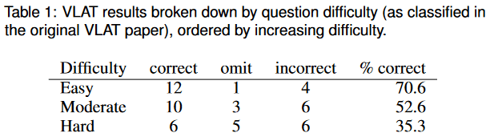
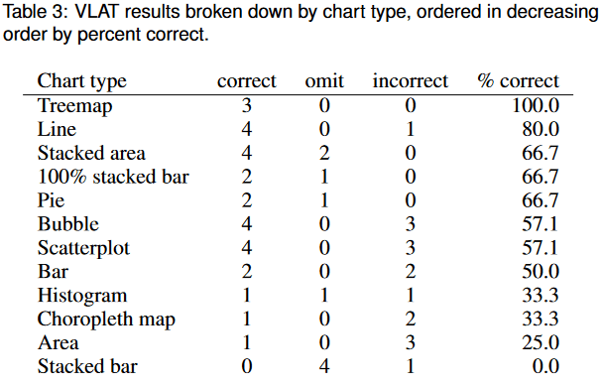
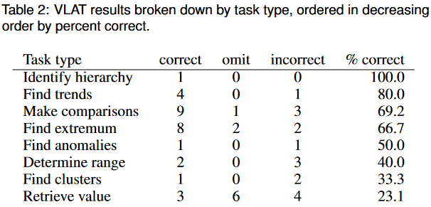
Visualization Literacy of LLMs
Results:
VLAT test results:
Not great overall
Performs very well on some tasks
Performs poorly on some tasks
Depends on chart type, too

Slide 7
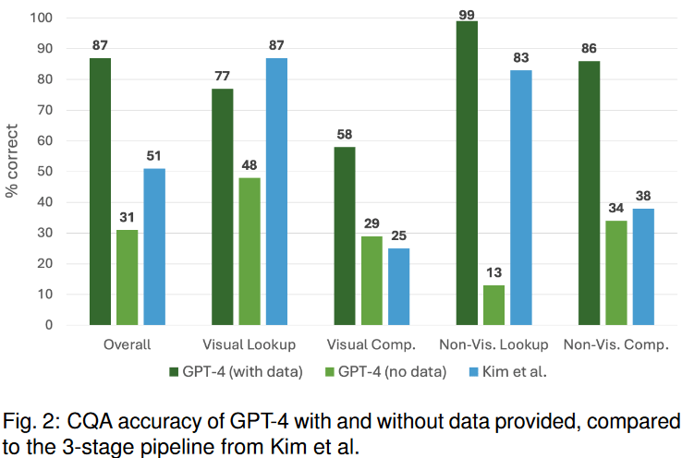
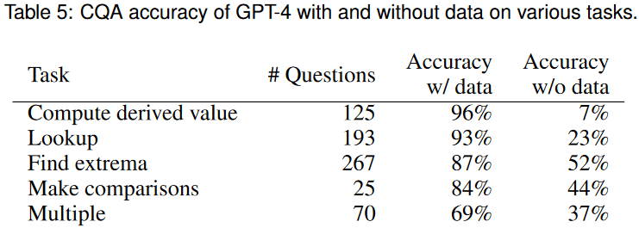
Visualization Literacy of LLMs
Results:
Chart Question Answering results:
Does well when data is provided
Pretty bad when no data is provided

Slide 8
Visualization Literacy of LLMs
Results:
Chart Question Answering results:
Does well when data is provided
Pretty bad when no data is provided
Depends on the task, too

Slide 9
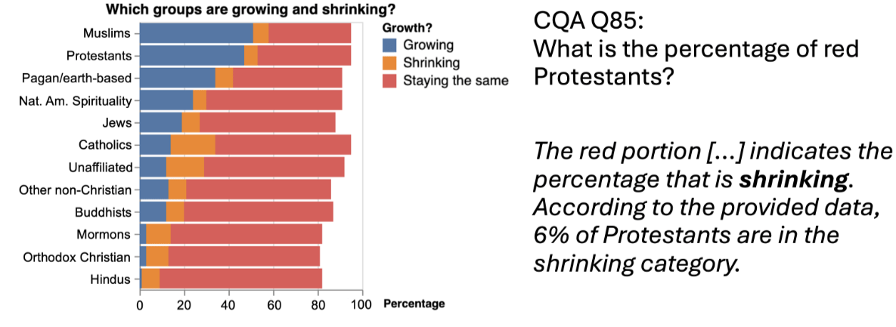
Visualization Literacy of LLMs
Results:
GPT-4 can’t recognize colors

Slide 10
LLMs for Detecting Misleading Visualizations
Misinformation is bad and arguably becoming more prevalent
But not everyone can detect misinformation reliably
Can multimodal Large Language Models (LLMs) help in detecting misinfo?

Slide 11
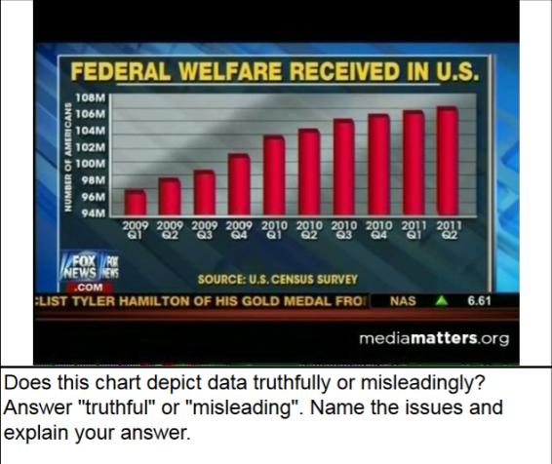
LLMs for Detecting Misleading Visualizations
Study:
Find many misleading visualizations
Prompt LLMs to detect misinformation
Three experiments:
Ask progressively more complex questions
Use charts with more and more types of issues
Lo, Leo Yu-Ho, and Huamin Qu. "How Good (Or Bad) Are LLMs at Detecting Misleading Visualizations?." IEEE Transactions on Visualization and Computer Graphics (2024).

Slide 12
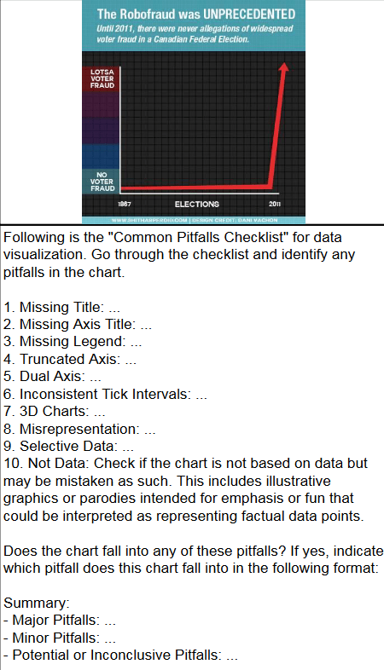
LLMs for Detecting Misleading Visualizations
Study:
Find many misleading visualizations
Prompt LLMs to detect misinformation
Three experiments:
Ask progressively more complex questions
Use charts with more and more types of issues

Slide 13
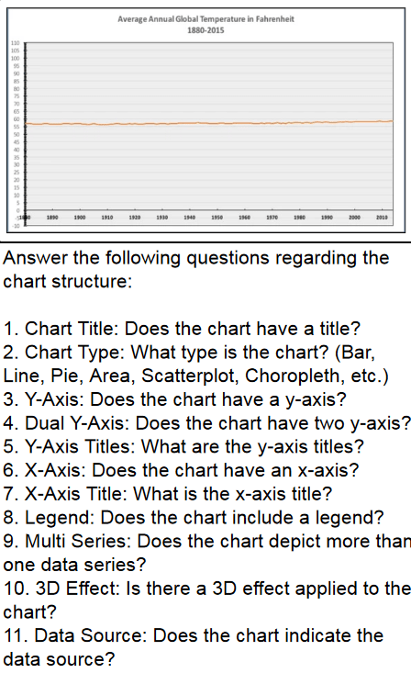
LLMs for Detecting Misleading Visualizations
Study:
Find many misleading visualizations
Prompt LLMs to detect misinformation
Three experiments:
Ask progressively more complex questions
Use charts with more and more types of issues

Slide 14
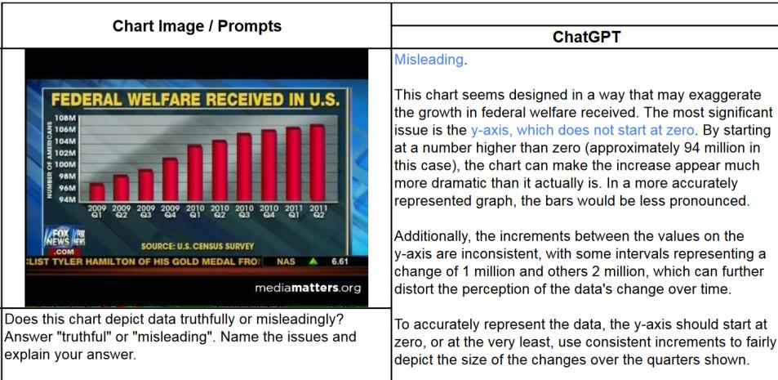
LLMs for Detecting Misleading Visualizations
Results:

Slide 15
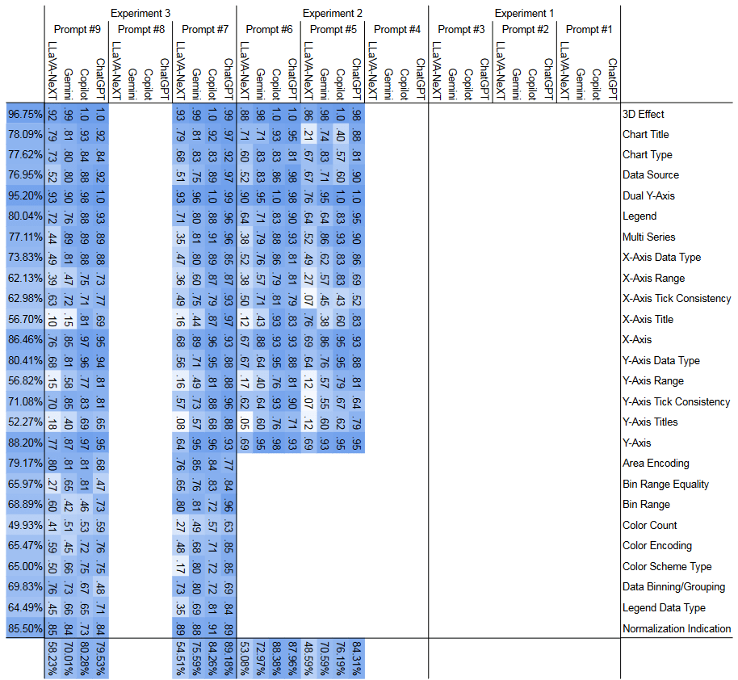
LLMs for Detecting Misleading Visualizations
Results:
LLMs are pretty good!
Correct responses to factual questions is consistently >60%, often 75%+
Lots of results in the paper

Slide 16
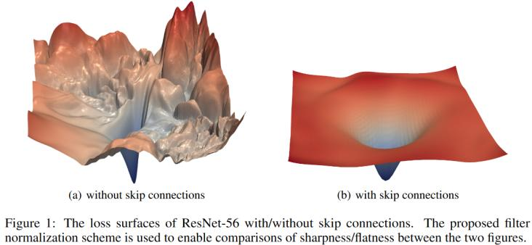
Understanding ML Optimization Through Viz
ML is highly a highly non-linear optimization problem
Optimization may get stuck in local minima
Hard to build intuition about the loss landscape
Visualization can help
Li, Hao, et al. "Visualizing the loss landscape of neural nets." Advances in neural information processing systems 31 (2018).

Slide 17
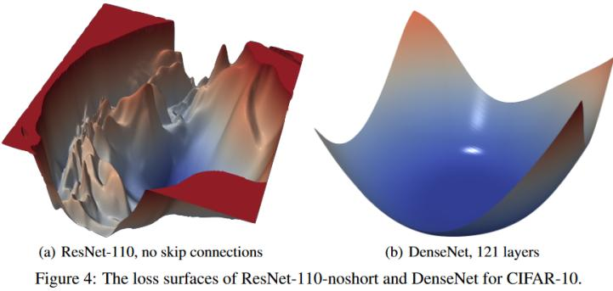
Understanding ML Optimization Through Viz
ML is highly a highly non-linear optimization problem
Optimization may get stuck in local minima
Hard to build intuition about the loss landscape
Visualization can help
Li, Hao, et al. "Visualizing the loss landscape of neural nets." Advances in neural information processing systems 31 (2018).

Slide 18
Interaction

Slide 19
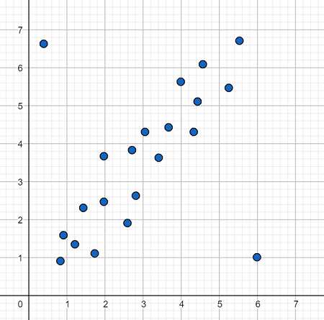
Attention-aware viz
Want you to look at certain components of the viz
How do we do this?
Depends on your attention
Some questions:
How should a viewer’s attention on a visualization be measured in real time?
How should a viewer’s attention on a visualization be recorded over time?
How should a visualization be modified to display the viewer’s attention over time?
Srinivasan, Arvind, et al. "Attention-Aware Visualization: Tracking and Responding to User Perception Over Time." IEEE Transactions on Visualization and Computer Graphics (2024).
Notes:
Want you to look at the outlier
How can we get you to do this?
ow should a viewer’s attention on a visualization be measured in real time?
How should a viewer’s attention on a visualization be recorded over time?
How should a visualization be modified to display the viewer’s attention over time?

Slide 20
Attention-aware viz
How should a viewer’s attention on a visualization be measured in real time?
Mouse movements
Touchscreen interaction (taps, scroll, zoom)
Gaze behavior
Tradeoff in availability of data

Slide 21

Attention-aware viz
How should a viewer’s attention on a visualization be recorded over time?
Two methods:
Data-agnostic:
No access to underlying data points
Only access to pixels

Slide 22
Attention-aware viz
How should a viewer’s attention on a visualization be recorded over time?
Two methods:
Data-agnostic:
No access to underlying data points
Only access to pixels
0
0
0
0
0

Slide 23
Attention-aware viz
How should a viewer’s attention on a visualization be recorded over time?
Two methods:
Data-agnostic:
No access to underlying data points
Only access to pixels
0
0
0
1
0

Slide 24
Attention-aware viz
How should a viewer’s attention on a visualization be recorded over time?
Two methods:
Data-agnostic:
No access to underlying data points
Only access to pixels
0
0
0
2
0

Slide 25
Attention-aware viz
How should a viewer’s attention on a visualization be recorded over time?
Two methods:
Data-agnostic:
No access to underlying data points
Only access to pixels
0
0
0
3
0

Slide 26
Attention-aware viz
How should a viewer’s attention on a visualization be recorded over time?
Two methods:
Data-agnostic:
No access to underlying data points
Only access to pixels
0
1
0
3
0

Slide 27
Attention-aware viz
How should a viewer’s attention on a visualization be recorded over time?
Two methods:
Data-agnostic:
No access to underlying data points
Only access to pixels
0
2
0
3
0

Slide 28
Attention-aware viz
How should a viewer’s attention on a visualization be recorded over time?
Two methods:
Data-agnostic:
No access to underlying data points
Only access to pixels
0
2
0
3
1

Slide 29
Attention-aware viz
How should a viewer’s attention on a visualization be recorded over time?
Two methods:
Data-agnostic:
No access to underlying data points
Only access to pixels
Data-aware:
Have direct access to data points
0
0
0
1

Slide 30
Attention-aware viz
How should a viewer’s attention on a visualization be recorded over time?
Two methods:
Data-agnostic:
No access to underlying data points
Only access to pixels
Data-aware:
Have direct access to data points
0
0
0
2

Slide 31
Attention-aware viz
How should a viewer’s attention on a visualization be recorded over time?
Two methods:
Data-agnostic:
No access to underlying data points
Only access to pixels
Data-aware:
Have direct access to data points
0
1
0
2

Slide 32
Attention-aware viz
How should a viewer’s attention on a visualization be recorded over time?
Two methods:
Data-agnostic:
No access to underlying data points
Only access to pixels
Data-aware:
Have direct access to data points
0
2
0
2

Slide 33
Attention-aware viz
How should a viewer’s attention on a visualization be recorded over time?
Two methods:
Data-agnostic:
No access to underlying data points
Only access to pixels
Data-aware:
Have direct access to data points
0
3
0
2

Slide 34
Attention-aware viz
How should a viewer’s attention on a visualization be recorded over time?
Two methods:
Data-agnostic:
No access to underlying data points
Only access to pixels
Data-aware:
Have direct access to data points
1
3
0
2

Slide 35
Attention-aware viz
How should a visualization be modified to display the viewer’s attention over time?
Four methods:
Modify marks
0
1
0
2

Slide 36
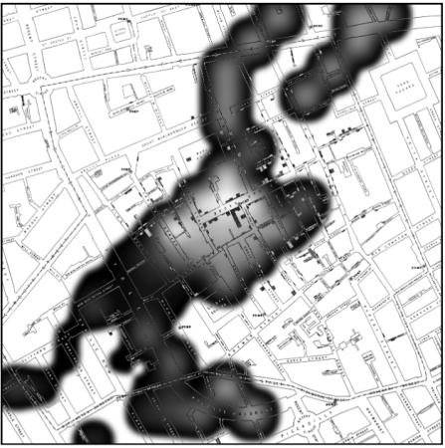
Attention-aware viz
How should a visualization be modified to display the viewer’s attention over time?
Four methods:
Modify marks
Overlay heatmap

Slide 37
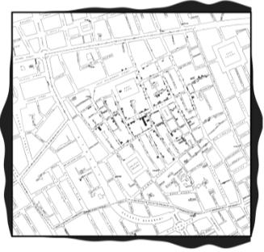
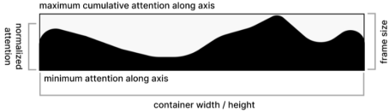
Attention-aware viz
How should a visualization be modified to display the viewer’s attention over time?
Four methods:
Modify marks
Overlay heatmap
Border

Slide 38
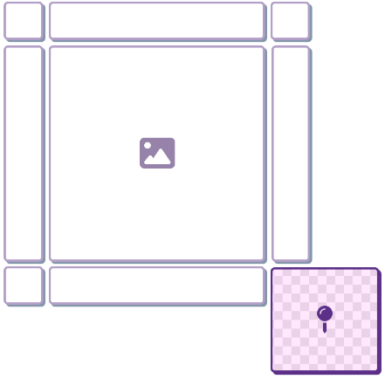
Attention-aware viz
How should a visualization be modified to display the viewer’s attention over time?
Four methods:
Modify marks
Overlay heatmap
Border
Mini-map

Slide 39
Attention-aware viz
How should attention visualization be triggered?
Three methods:
Always on
Explicit triggering
Implicit triggering
Emphasis
De-emphasis
Notes:
Explicit: button press
Implicit: trigger the visualization based on if a threshold is surpassed

Slide 40
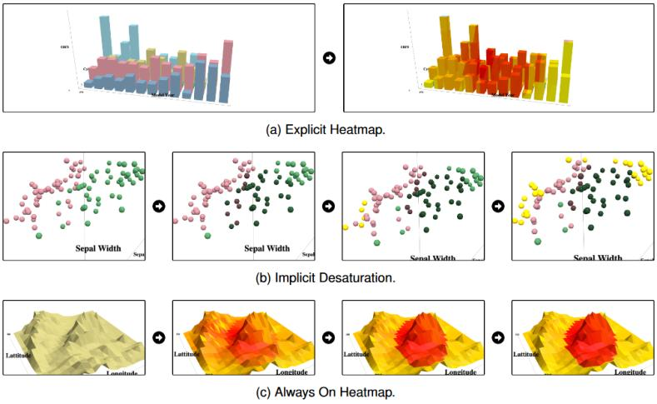
Attention-aware viz
Examples

Slide 41
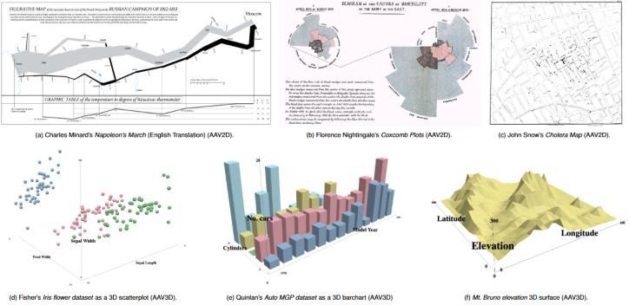
Attention-aware viz
User study
Open-ended questions to encourage exploration
Participants assigned a random combination of:
Attention presentation
Triggering mechanism
Qualitative evaluation
Interviews
Notes:
Explain counterbalancing

Slide 42
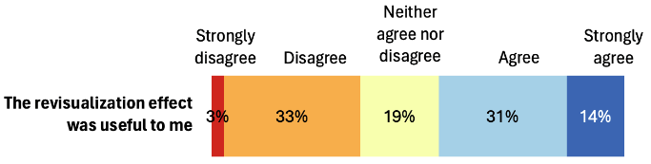
Attention-aware viz
Results
Participants thought it was useful
Encouraged exploration
Design of the attention visualization and triggering method is important
Don’t want to be too distracting/obscure the data
Preferred explicit control over always-on
Individual preference differences
Notes:
Border and minimap preferred

Slide 43
Embodied Data Selection in VR
Many existing techniques for zoom/select-and-focus in 2D viz (show examples from class?)
Under-explored in 3D and immserive viz, though
Problem: data in a room-scale immersive viz is often out of reach. Eg you cant reach the front of the classroom without getting out of your seat
Solution: VR embodiment + extended virtual hand!
Direct manipulation: fist gesture → gain scaling on arm reach, portal attached to virtual hand
Indirect manipulation: use joystick to control portal placement
Pilot study → direct manipulation was preferred
Does haptic feedback for touching data points help?
User study:
3D immersive viz. 10m (w) x 10m (h) x 8m (d)
Point selection task: interact with the highlighted point, 30x repetitions
Conditions: with and without portal
Measures: movements, fatigue, usability and preference questionnaires, general comments
Results:
Experiment 1: portal vs no portal
Similar completion time with and without portals
Shorter trajectory length with portals (less fatigue)
Fewer attempts with portals (higher success rate)
Lower fatigue
Experiment 2: haptics vs no haptics
Similar results for haptics and no-haptics conditions
Subjective user-reported preference for haptics

Slide 44
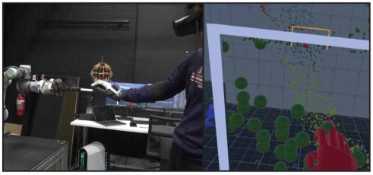
Embodied Data Selection in VR
Many existing techniques for zoom/select-and-focus in 2D viz
https://observablehq.com/@d3/zoom-to-bounding-box
Under-explored technique for 3D viz!
Problem: Data in a room-scale immersive viz is often out of reach.
Solution: VR embodiment + extended virtual hand!
Rubber hand illusion: https://www.youtube.com/watch?v=sxwn1w7MJvk
Works in VR: https://www.youtube.com/watch?v=Ljs1wKfkwqI
Embodied hand + exaggerated virtual arm length
https://youtu.be/u5kXfusd8Wg?t=39
Place a portal at the virtual hand
Dai, Shaozhang, et al. "Precise Embodied Data Selection with Haptic Feedback while Retaining Room-Scale Visualisation Context." IEEE Transactions on Visualization and Computer Graphics (2024).
Notes:
Out of reach example: you cant reach the front of the classroom without getting out of your seat

Slide 45
Embodied Data Selection in VR
Pilot study:
Do users prefer direct or indirect hand manipulation?
Embodied virtual hand vs joystick control of hand
Result: users prefer embodied virtual hand
Main user study:
3D immersive viz. 10m (w) x 10m (h) x 8m (d)
Point selection task: interact with the highlighted point, 30x repetitions
https://youtu.be/u5kXfusd8Wg?t=96
Conditions: with and without portal, with and without haptic feedback
Measures: movements, fatigue, usability and preference questionnaires, general comments

Slide 46
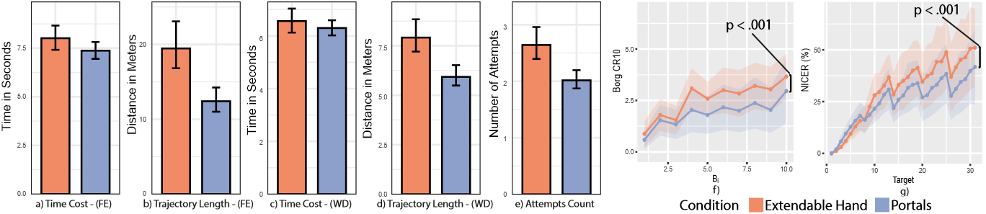
Embodied Data Selection in VR
Results:
Experiment 1: portal vs no portal
Similar completion time with and without portals
Shorter trajectory length with portals (less fatigue)
Fewer attempts with portals (higher success rate)
Lower fatigue

Slide 47
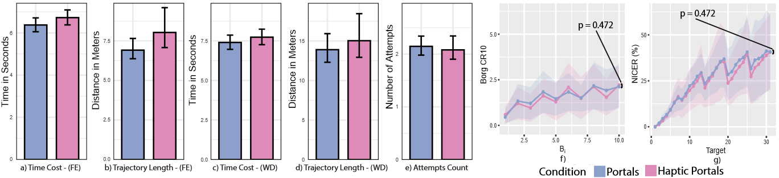
Embodied Data Selection in VR
Results:
Experiment 1: portal vs no portal
Similar completion time with and without portals
Shorter trajectory length with portals (less fatigue)
Fewer attempts with portals (higher success rate)
Lower fatigue
Experiment 2: haptics vs no haptics
Similar results for haptics and no-haptics conditions
Subjective user-reported preference for haptics

Slide 48
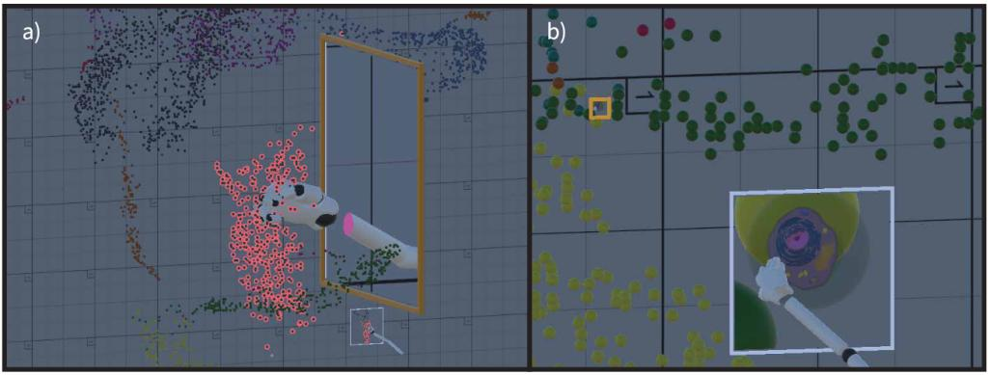
Embodied Data Selection in VR
Applications: https://youtu.be/u5kXfusd8Wg?t=157

Slide 49
Data Viz Theory

Slide 50
What Do University Students Learn In Viz Class?
Data visualizations are everywhere in the wild
Data viz literacy is important!
Be able to spot misinformation/propaganda/bad science
Present your data/results/ideas optimally
How do students develop viz literacy over time?
Specifically: How university students read visualizations differently before and after taking a visualization course?
Hedayati, Maryam, and Matthew Kay. "What University Students Learn In Visualization Classes." IEEE Transactions on Visualization and Computer Graphics (2024).

Slide 51
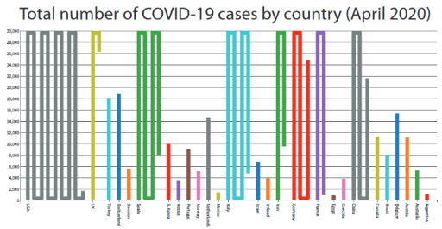
What Do University Students Learn In Viz Class?
User study
Task:
Verbal walkthrough of 2 unfamiliar visualizations
First week and last week of semester
Think out loud
Four visualization types:
Wrapped bar chart

Slide 52
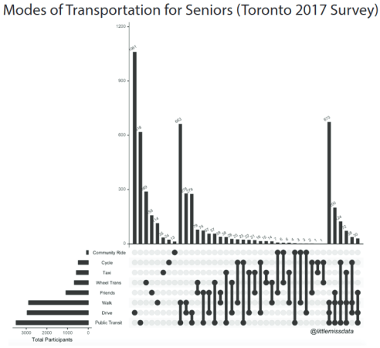
What Do University Students Learn In Viz Class?
User study
Task:
Verbal walkthrough of 2 unfamiliar visualizations
First week and last week of semester
Think out loud
Four visualization types:
Wrapped bar chart
Upset

Slide 53
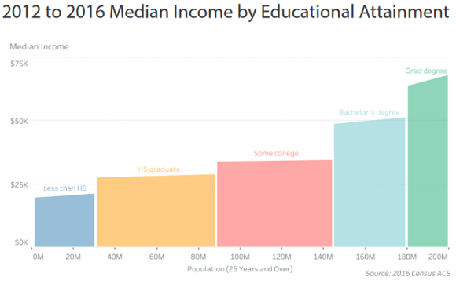
What Do University Students Learn In Viz Class?
User study
Task:
Verbal walkthrough of 2 unfamiliar visualizations
First week and last week of semester
Think out loud
Four visualization types:
Wrapped bar chart
Upset
Marimekko slope chart

Slide 54
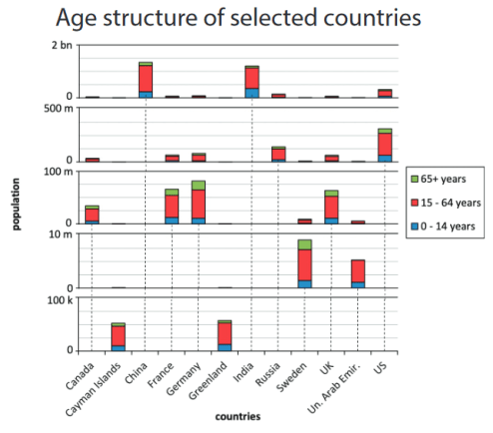
What Do University Students Learn In Viz Class?
User study
Task:
Verbal walkthrough of 2 unfamiliar visualizations
First week and last week of semester
Think out loud
Four visualization types:
Wrapped bar chart
Upset
Marimekko slope chart
Scale-stack bar chart

Slide 55
What Do University Students Learn In Viz Class?
User study
Task:
Verbal walkthrough of 2 unfamiliar visualizations
First week and last week of semester
Think out loud
Four visualization types:
Wrapped bar chart
Upset
Marimekko slope chart
Scale-stack bar chart
Viz Literacy Assessment Test
Tests a person’s understanding of viz
Lee, Sukwon, Sung-Hee Kim, and Bum Chul Kwon. “VLAT: Development of a visualization literacy assessment test." IEEE transactions on visualization and computer graphics 23.1 (2016): 551-560.

Slide 56
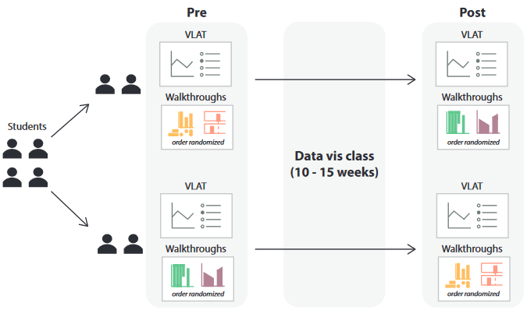
What Do University Students Learn In Viz Class?
User study
Participants:
Upper-level viz class
Multiple R1 universities
16 students completed both sessions
Various amounts of prior experience
13/16 took a stats course
5/16 took a data science course
2/16 took a data viz course
6/16 used viz in work/research

Slide 57
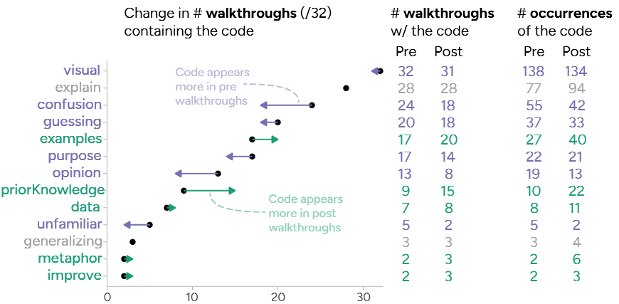
What Do University Students Learn In Viz Class?
Results
Coded users’ think out-loud monologues
Notes:
Purple = cognitive process
Green = analytical and design-related
Grey = general/neutral comments
Less confusion and opinions, less negative opininos
More examples and calling upon prior knowledge → put to practice what they learned!

Slide 58
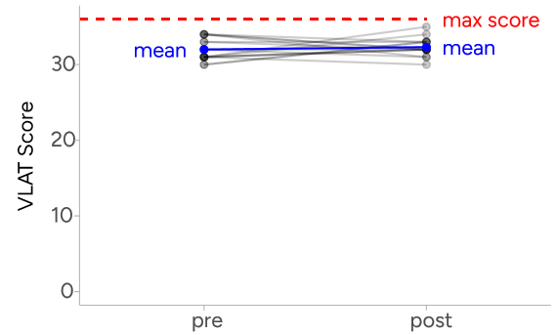
What Do University Students Learn In Viz Class?
Results
VLAT scores
Not a perfect metric
Focuses on viz comprehension, not on viz design
Notes:
Ceiling effect

Slide 59
What Do University Students Learn In Viz Class?
Limitations: ideas?
Second VLAT test was during finals week
The 4 viz types shown in the test were quite different
Small sample size
Can’t control for students’ academic performance in the class
Notes:
FERPA

Slide 60
Perception

Slide 61
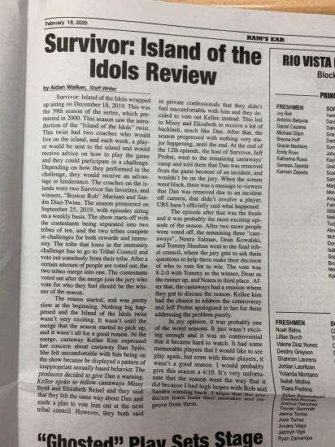
Viz Reading Order
People read text in a specific order
Sentence-by-sentence comparisons
Combine comparisons to get the big picture of the full article

Slide 62
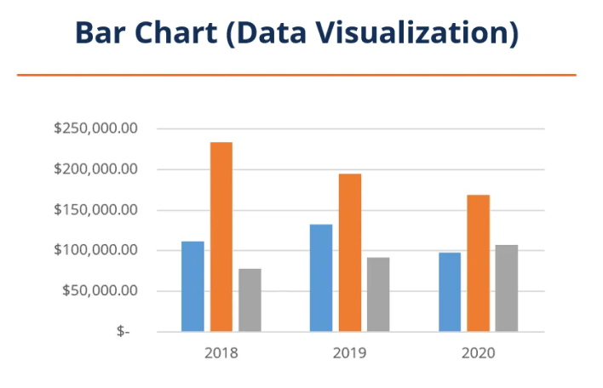
Viz Reading Order
Question: In what “order” do people read a visualization?
Bearfield, Cindy Xiong, et al. "What does the chart say? grouping cues guide viewer comparisons and conclusions in bar charts." IEEE Transactions on Visualization and Computer Graphics (2023).

Slide 63
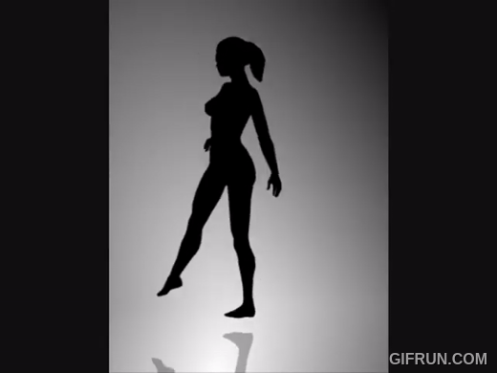

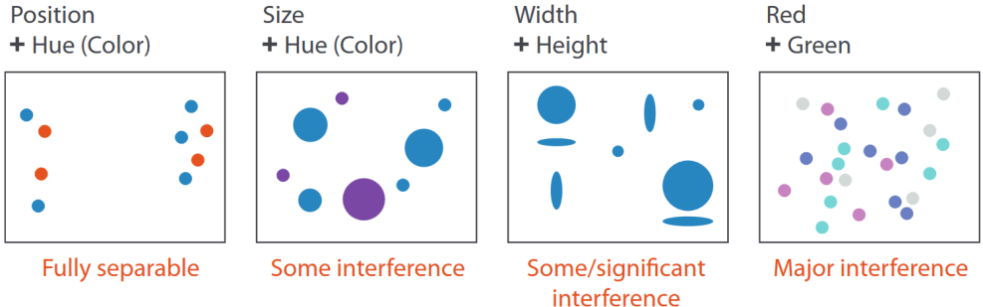
Viz Reading Order
Top-down processing
Gestalt laws: Perceptual grouping

Slide 64
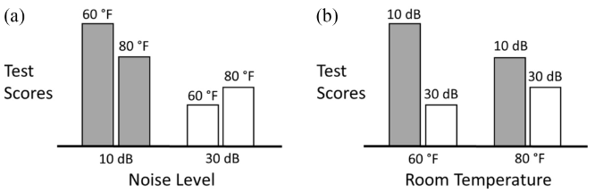
Viz Reading Order
Question: In what “order” do people read a visualization?

Slide 65
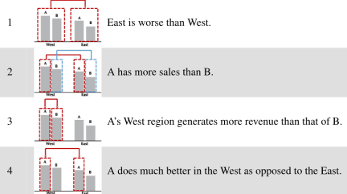
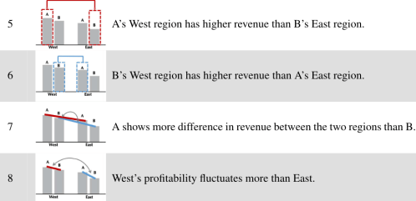
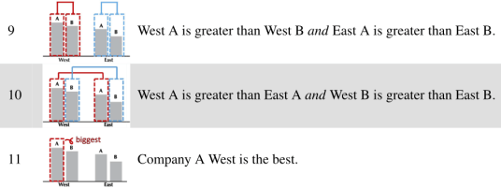
Viz Reading Order
Similar to reading text: comparisons of marks in the viz

Slide 66
Viz Reading Order
Question: In what “order” do people read a visualization?
Hypotheses:
The authors hypothesized that people will make different kinds of comparisons with different frequencies: Ideas?
Superlative (min/max) comparisons
Group comparisons
Pair comparisons
Second-order comparisons

Slide 67
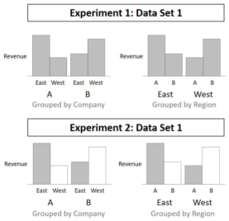
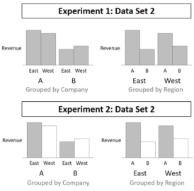
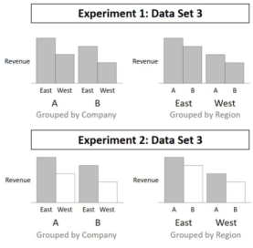
Viz Reading Order
User study:
Ask users to write down 3 conclusions about different visualizations
Very open-ended
Qualitative data

Slide 68
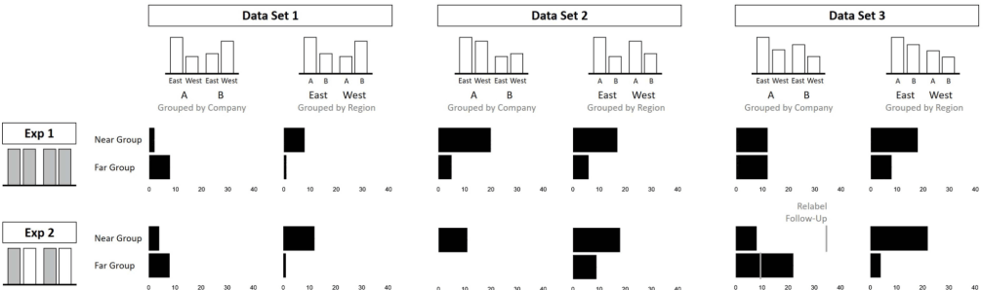
Viz Reading Order
Results:
Group comparisons made primarily based on spatial proximity

Slide 69
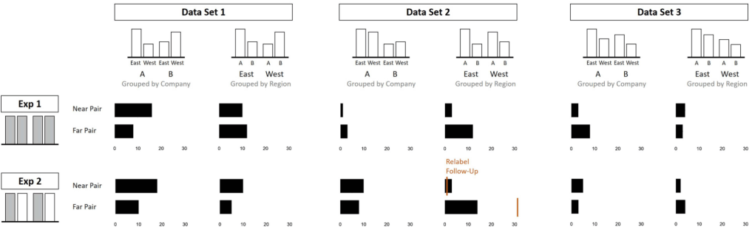
Viz Reading Order
Results:
Pairwise comparisons made primarily based on spatial proximity (near/far pairs)
Notes:
Rarely did edge and center comparisons

Slide 70
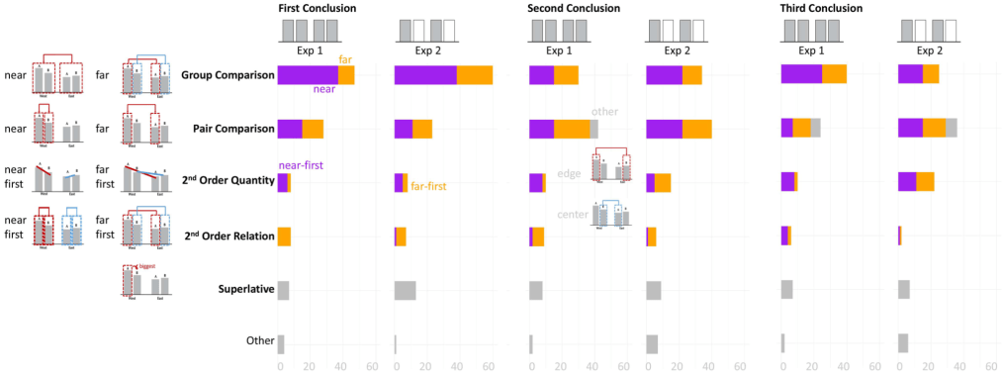
Viz Reading Order
Results:
Full frequency ranking for comparison types

Slide 71
Visual Channel Effectiveness Ranking
Previous work measured how accurately people can read data values based on different encodings
However, previous work only measured comparisons of 2 marks at a time.
Real-world data viz is more complex: multiple comparisons!
User study:
Briefly show the user a viz → remove the viz → ask them to re-create the viz
Conditions: visual channel, # of marks (working memory
Position (bar), position (line), luminance, length, area, angle
Unlike previous studies, users must recreate the viz (rather than report values)
Measures: bias, precision, error
Results:
Traditional rankings do not hold! Task is more complex
Rankings varied depending on the number of marks
Channel effectiveness changed based on task
Notes:
bias is how the mean of the responses deviates from the actual value presented as the reference
Precision is the consistency of participants’ responses; they may consistently report the same value, regardless of the reference value.
error measures how each response deviates from the reference value.

Slide 72
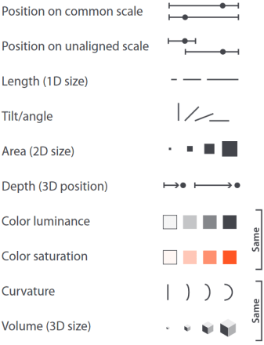
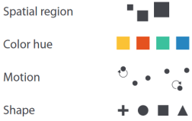
Visual Channel Effectiveness Ranking
Previous work measured how accurately people can read data values based on different encodings
However, previous work only measured comparisons of 2 marks at a time.
Real-world data viz is more complex: multiple comparisons!
Question: Do these rankings hold for more complex data viz tasks?
McColeman, Caitlyn M., et al. "Rethinking the ranks of visual channels." IEEE Transactions on Visualization and Computer Graphics 28.1 (2021): 707-717.

Slide 73
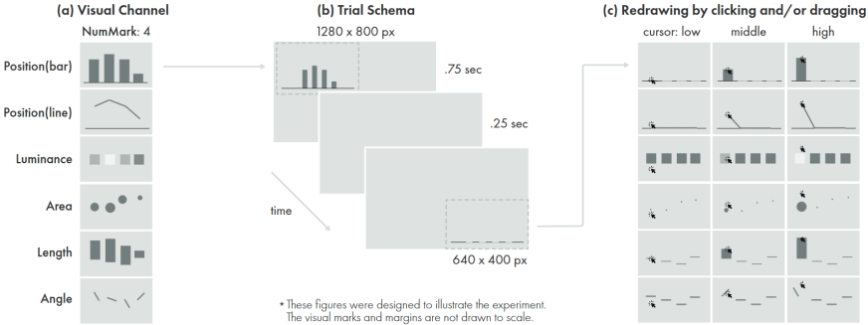
Visual Channel Effectiveness Ranking
User study:
Briefly show the user a viz → remove the viz → ask them to re-create the viz
Conditions: visual channel, # of marks (working memory
Position (bar), position (line), luminance, length, area, angle
Unlike previous studies, users must recreate the viz (rather than report values)
Measures: bias, precision, error

Slide 74

Visual Channel Effectiveness Ranking
User study:
Briefly show the user a viz → remove the viz → ask them to re-create the viz
Conditions: visual channel, # of marks (working memory
Position (bar), position (line), luminance, length, area, angle
Unlike previous studies, users must recreate the viz (rather than report values)
Measures: bias, precision, error

Slide 75

Visual Channel Effectiveness Ranking
Results:
Traditional rankings do not hold! Task is more complex
Rankings varied depending on the number of marks
Channel effectiveness changed based on task

Slide 76

Visual Channel Effectiveness Ranking
Results:
Traditional rankings do not hold! Task is more complex
Rankings varied depending on the number of marks
Channel effectiveness changed based on task

Slide 77

Foveated Rendering for Volumetric Data
Volumetric data is very expensive to render
Highly detailed, 3D data
Important for medical fields and nature sciences (clouds, fluids, land, etc.)

Slide 78

Foveated Rendering for Volumetric Data
Volumetric data is very expensive to render
Highly detailed, 3D data
Important for medical fields and nature sciences (clouds, fluids, land, etc.)
Visual quality is MUCH better in the fovea
We can exploit this for improved rendering performance!
https://www.nvidia.com/en-us/on-demand/session/gtcfall21-a31223/
Bauer, David, Qi Wu, and Kwan-Liu Ma. "Fovolnet: Fast volume rendering using foveated deep neural networks." IEEE transactions on visualization and computer graphics 29.1 (2022): 515-525.

Slide 79

Foveated Rendering for Volumetric Data
Solution:
Machine learning model to reconstruct sparse version of the full volumetric dataset
Render in lower quality in the periphery → user cannot notice the difference
Results:

Slide 80

Foveated Rendering for Volumetric Data
Solution:
Machine learning model to reconstruct sparse version of the full volumetric dataset
Render in lower quality in the periphery → user cannot notice the difference
Results:

Slide 81
TODO
TODO

